Slide 1


A Feature Modulation Block-aided Dual-Branch of Swin Transformer and Ensemble of CNN Models for Breast Cancer Classification
Debatra Banerjee, Irina Shpakovskaya, Dmitrii Kaplun, Mahantapas Kundu, Ram Sarkar
PRESENTED BY – Debatra Banerjee
JADAVPUR UNIVERSITY, KOLKATA, INDIA
Paper ID- 11
presented at MECO’2026 and CPSIoT’2026, Budva, Montenegro, June 09-12
www.mecoconference.me

Slide 2
Outline
Problem definition
State-of-the-arts
Methods/Approach
Results
Conclusions

Slide 3
Problem definition
Clinical Challenge
Breast cancer remains a leading and deadly disease for women globally, making early and accurate detection vital for patient survival.
While manual inspection of H&E-stained biopsy slides is the clinical gold standard, it is highly time-consuming and subject to inter-observer variability.
Why is Whole slide Image Classification Hard?
• Texture vs. Structure: Models struggle to jointly capture fine-grained cellular textures and large-scale tissue architectures.
• CNN Limitations: Convolutional networks excel at local spatial features but lack global semantic capturing ability.
• Transformer Limitations: Vision Transformers excel at global long-range context but struggle with highly detailed, local patterns
• Dataset Artifacts: Severe class imbalances, staining variations, and limited data availability heavily degrade model generalization.

Slide 4
Problem solution
Proposed Solution
The proposed Swin-CNNs framework integrates a hierarchical Swin Transformer with a lightweight CNN ensemble (SqueezeNet 1.1 and ShuffleNet v2 x1.0) via a Feature-wise Linear Modulation (FiLM) module.
This allows transformer-derived global semantics to dynamically modulate local CNN spatial features, creating a highly discriminative, context-aware representation.
The model achieves exceptional test accuracies of 97.05% on the BreakHis dataset and 99% on the BACH dataset.

Slide 5
State-of-the-art
BreakHis Dataset
Authors | Method | Accuracy | Description
Desai et al[8] | ResNet ar-chitectures | 0.97 | ResNet architectures: fine-tuned deep residual CNNs for multi-class breast-cancer subtype classification.
Lekha S. Nair et al.[9] | SE-Conformer | 0.97 | SE-Conformer: combined Squeeze-and-Excitation channel attention with a Conformer hybrid for malignancy detection.
Yıldız et al.[10] | Deep ensemble | 0.93 | Deep ensemble: aggregated multiple CNN backbones for robust diagnosis of cancer subtypes.
Fatima et al.[11] | VGG16-TL | 0.95 | VGG16 transfer learning: leveraged ImageNet-pretrained VGG16 features with a comparative ML analysis.
Cai et al.[7] | AMRM-ResNet | 0.96 | AMRM (Attention-based Mask Reconstruction) on a ResNet backbone for multi-class histopathology classification.
Proposed | Swin-CNNs | 0.99
MECO’2026 & CPSIoT’2026, June 09-12, Budva, Montenegro

Slide 6
State-of-the-art
BACH Dataset
Authors | Method | Accuracy | Description
Nazeri et al.[22] | Two-stage CNN | 0.95 | Two-stage CNN: a coarse-to-fine convolutional pipeline that first extracts patch features and then aggregates them for whole-image classification.
Zhang et al.[3] | SPCZP-CNN | 0.96 | SPCZP-CNN: a sparse pyramid pooling CNN that captures multi-scale histological structures for four-class BACH classification
Lekha S. Nair et al.[9] | SE-Conformer | 0.90 | SE-Conformer: SE-attention–augmented Conformer hybrid evaluated on the BACH four-class problem
Fatima et al.[11] | VGG16-TL | 0.95 | VGG16 transfer learning: pretrained-VGG16 feature extractor with comparative classifier analysis on BACH images
Liang et al.[6] | Brea-Net | 0.95 | Brea-Net: an interpretable dual-attention network designed for imbalanced breast-cancer classification.
Proposed | Swin-CNNs | 0.99 | 0.99
MECO’2026 & CPSIoT’2026, June 09-12, Budva, Montenegro

Slide 7
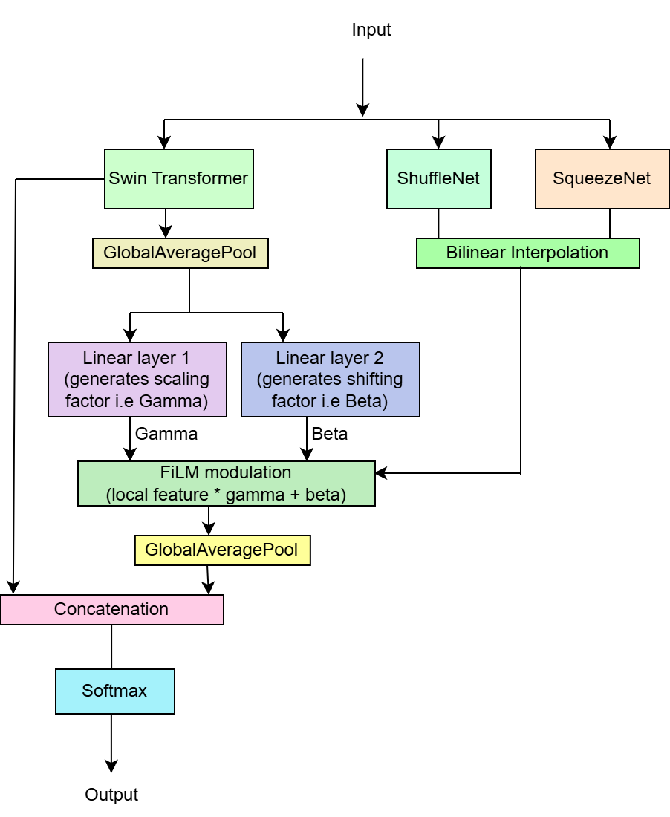
Architecture Overview

Slide 8
Method/Approach
Dual-Branch Input Flow: Simultaneously processes input tensors through a global Swin Transformer path and a local ensembled CNN path.
Swin Transformer (Global Branch): Utilizes shifted-window self-attention across four hierarchical stages to extract macro-tissue semantic contexts ([B, 7, 7, 768]).
Ensembled CNN (Local Branch): Combines SqueezeNet 1.1 and ShuffleNet v2 x1.0 with bilinear feature alignment to capture fine-grained cellular textures ([B, 512, 13, 13]).
FiLM Fusion Module: Extracts global semantic context vectors via global pooling to dynamically generate scaling (gamma) and shifting (beta) factors that adaptively modulate local CNN spatial feature maps.
Final Classification: Unifies both streams via global pooling and concatenation into a joint vector ([B, 1280]) for logit prediction and Softmax normalization.

Slide 9
Experiments/Testings
Dataset | Total | Train | Validation | Test
BreakHis | Oversampled / Undersampled around average class size | 70% | 15% | 15%
ICIAR BACH 2018 | Augmented to 8000 total (2000 per class) | 70% | 15% | 15%

Slide 10
Experiments/Testings
Preprocessing & Training Setup
Image Quality Enhancement & Augmentation: Applied Contrast Limited Adaptive Histogram Equalization (CLAHE) to improve local contrast. Addressed BACH data scarcity via extensive translation and shearing augmentations.
Optimizer & Learning Rate Schedule: Trained using AdamW with an initial learning rate of 5X10⁻⁵, weight decay of 1X10⁻³, and a CosineAnnealingLR scheduler (T_{max}=30, eta_{min}=1X10⁻⁶).
Execution Settings: Configured with a batch size of 32, a maximum duration of 30 epochs, and data shuffling enabled exclusively for the training stream.
Loss Function & Model Selection: Evaluated via standard CrossEntropy Loss with mean reduction. Integrated early stopping with a patience of 7 epochs, saving the best checkpoint based on peak validation accuracy.

Slide 11
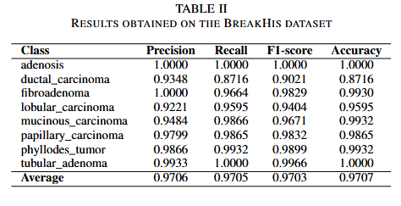
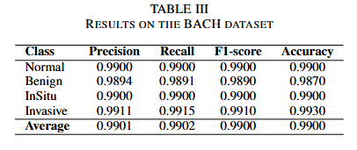
Results
Accuracy of Swin-Ensembled CNN fusion model for different classes for different datasets

Slide 12
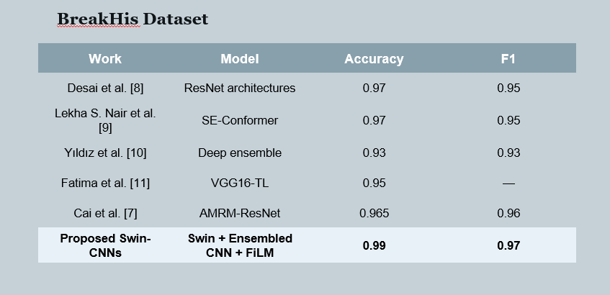
Results

Slide 13
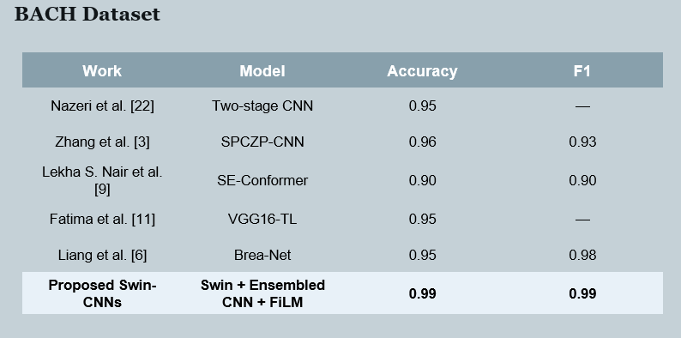
Results

Slide 14
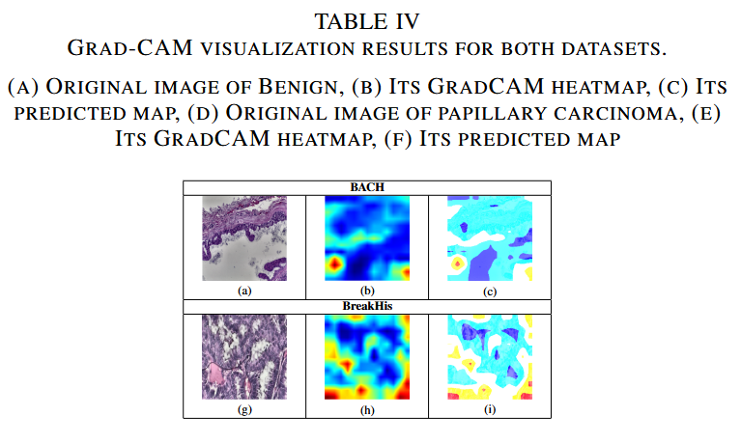
Visualization

Slide 15
Conclusions
Key Contributions
Dual-Branch Semantics: Integrates a hierarchical Swin Transformer with a lightweight CNN ensemble to model long-range global context and extract fine-grained local cellular textures simultaneously.
Linear FiLM Modulation: Implements a Feature-wise Linear Modulation module to dynamically scale and shift local feature maps using transformer-derived global semantic cues.
State-of-the-Art Performance: Outperforms contemporary architectures, achieving peak test accuracies of 97.05% on BreakHis and 99% on the BACH benchmark dataset.
Limitations & Future Scope
Ductal Carcinoma Deficiencies: The framework exhibits a slight performance degradation on BreakHis ductal carcinoma samples, misclassifying 16 out of 145 test images.
Alternative Fusion Mechanisms: Future work requires exploration of customized attention blocks and more sophisticated feature-mixing modules to replace basic concatenation steps.
Advanced Preprocessing Pipeline: Investigation into alternative, adaptive image enhancement techniques is needed to further improve input quality, feature extraction boundaries, and structural alignment

Slide 16
Key References
[1] F. N. Iandola, S. Han, M. W. Moskewicz, K. Ashraf, W. J. Dally, and K. Keutzer. "SqueezeNet: AlexNet-level accuracy with 50x fewer parameters and <0.5 MB model size." arXiv:1602.07360, 2016.
[2] X. Zhang, X. Zhou, M. Lin, and J. Sun. "ShuffleNet: An extremely efficient convolutional neural network for mobile devices." CVPR, 2018.
[3] N. Ma, X. Zhang, H.-T. Zheng, and J. Sun. "ShuffleNet V2: Practical guidelines for efficient CNN architecture design." ECCV, 2018.
[4] Z. Liu, Y. Lin, Y. Cao, H. Hu, Y. Wei, Z. Zhang, S. Lin, and B. Guo. "Swin Transformer: Hierarchical vision transformer using shifted windows." ICCV, 2021.
[5] K. Zuiderveld. "Contrast limited adaptive histogram equalization." Graphics Gems IV, pp. 474–485, Academic Press, 1994.
[6] Y. Liang and Z. Meng. "Brea-Net: An interpretable dual-attention network for imbalanced breast cancer classification." IEEE Access, 2023.
[7] Y. Cai, X. Chen, and C. Guo. "AMRM: Attention-based mask reconstruction module for multi-classification of breast cancer histopathological images." Guangdong Univ. of Technology, 2024.
[8] A. Desai and R. Mahto. "Multi-class classification of breast cancer subtypes using ResNet architectures on histopathological images." California State Univ., Fullerton, 2024.
[9] L. S. Nair, K. R. Amarnath, and J. J. Nair. "Advancing breast cancer detection: SE-Conformer framework for malignancy detection in histopathology images." 2025.
[10] G. Yıldız and Ö. Yakut. "Multi-class cancer diagnosis on histopathological images with deep ensemble learning model." Computers in Biology and Medicine, vol. 180, p. 111381, 2025.
[11] N. Fatima, L. Liu, S. Hong, and H. Ahmed. "Prediction of breast cancer, comparative review of machine learning techniques, and their analysis." IEEE, 2020.
[12] A. Kumar, C. Singh, and M. K. Sachan. "A moment-based pooling approach in CNNs for breast cancer histopathology image classification." Neural Computing and Applications, vol. 37, pp. 1127–1156, 2025.

Slide 17
Key References
[13] T. Li, B. Li, and C. Zheng. "Dual-branch attention fusion network for pneumonia detection." Biomedical Physics & Engineering Express, vol. 11, no. 5, p. 055025, 2025.
[14] E. Perez, F. Strub, H. de Vries, V. Dumoulin, and A. Courville. "FiLM: Visual reasoning with a general conditioning layer." AAAI, 2018.
[15] Y. Wen, Y. Zeng, S. Liu, L. Xiong, H. Li, Y. Wang, W. Jia, C. Wang, P. Ma, and Z. Liang. "DSF-Net: A dual-stream fusion network integrating structural and detailed features for fundus-based diabetic retinopathy classification." 2023.
[16] S. Hussain, M. A. Teevno, U. Naseem, D. B. Avendaño Avalos, S. Cardona-Huerta, and J. G. Tamez-Peña. "Multiview multimodal feature fusion for breast cancer classification using deep learning." IEEE, 2024.
[17] J. Huang, S. N. Saw, T. He, R. Yang, Y. Qin, and Y. Chen. "DCNNLFS: A dilated CNN with late fusion strategy for gastric histopathology classification." IEEE, 2024.
[18] R. Zhang, Y. Zheng, W. C. T. Mak, and R. Yu. "Automatic detection and classification of colorectal polyps by transferring low-level CNN features from non-medical domain." IEEE J. Biomedical and Health Informatics.
[19] M. Mamun, M. I. Mahmud, M. Meherin, and A. Abdelgawad. "LCDctCNN: Lung cancer diagnosis of CT scan images using CNN based model." SPIN, 2023.
[20] Y. Li, M. E. H. Daho, P.-H. Conze, R. Zeghlache, et al. "A review of deep learning-based information fusion techniques for multimodal medical image classification." arXiv, 2023.
[21] S. Chi, Z. Wang, L. Jang, and M. Gong. "Max-min pooling and squeeze excitation lightweight bidirectional Mamba for image classification." 2024.
[22] K. Nazeri, A. Aminpour, and M. Ebrahimi. "Two-stage convolutional neural network for breast cancer histology image classification." ICIAR, Springer, 2018, pp. 717–726.

Slide 18
THANK YOU
Q&A
Debatra Banerjee
debatrabanerjee1001@gmail.com

